Slide 1
PROPERTY RENTAL MANAGEMENT SYSTEM
SRI VAISHNAVI AEKKATI - NUID : 002760439
AKSHITA PATHANIA - NUID : 002728833
AMRUTHA EDARA - NUID : 002776773
SAMPADA KASTURE - NUID : 002743809

Slide 2
PROBLEM STATEMENT
A well-established property management system is a necessity for people to have an easy and efficient way to rent a property that they desire based on the location, address, and price. In a poorly organized and used property management system, keeping a huge number of tenant files could turn out to be tedious and can result in hours of confusion and redundancies.

Slide 3
OBJECTIVES
Implementing a successful property management system is important as it is required by people who are moving to a new city or country to have a systematic interpretation of how they can easily get access to the unit according to their convenience and within their budget. The utmost priority of our project will be to appropriately use our technical and organizational skills to implement a safe and easy property management system that will act as a link between the manager and the tenant.

Slide 4
PROPOSED SOLUTION
1. A different entity will be made to look after the problems of the tenants i.e. maintenance entity..
2. Monitoring of the database activity with the usage patterns will be done on regular bases by manager.
3. User access rights and privileges will be managed and will not be given to the other users or the property managers.
4. A well-designed property system will be created that will be storing all the data in one place and have full control over it making the data transparent and easy to find.

Slide 5
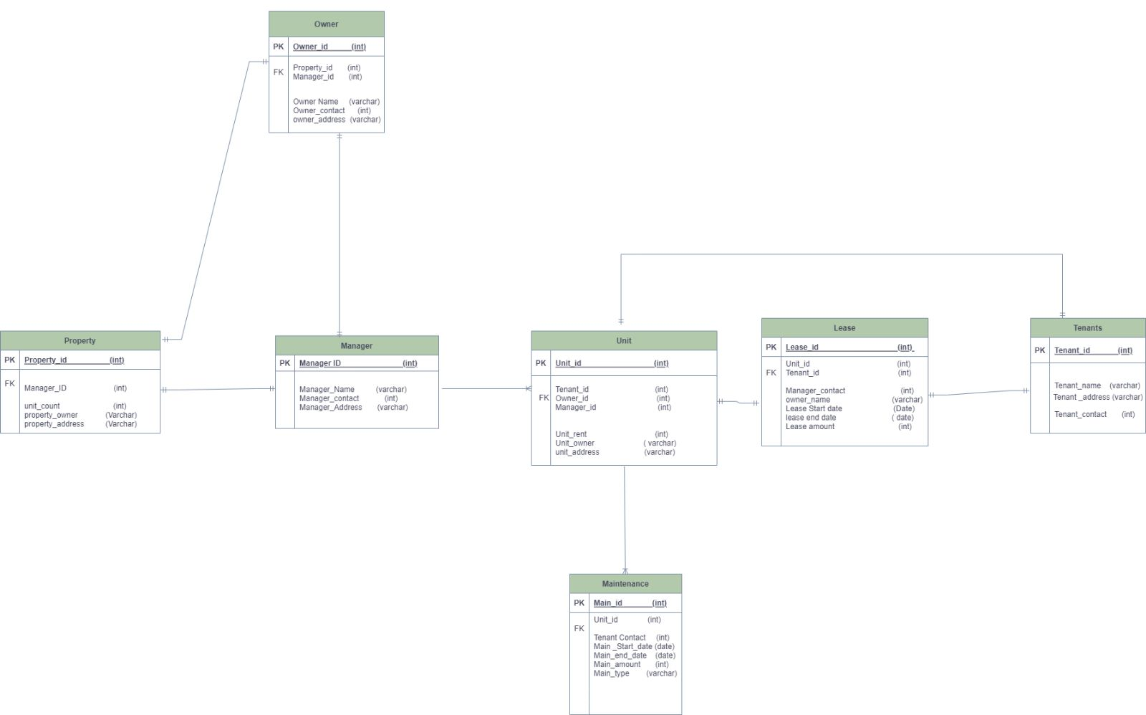
ER Diagram

Slide 6
ENTITIES
Manager
Tenants
Property
Owner
Unit
Maintenance
Lease

Slide 7
BUSINESS RULES
1. Our Property Rental Management System currently manages a single property with many units.
2. The Owner should have a unique property with one or more units managed by a single owner.
3. Every unit should have unique tenants.
4. One Unit at a time can have only one lease.
5. Any tenant can report any number of issues at a time in maintenance entity.

Slide 8
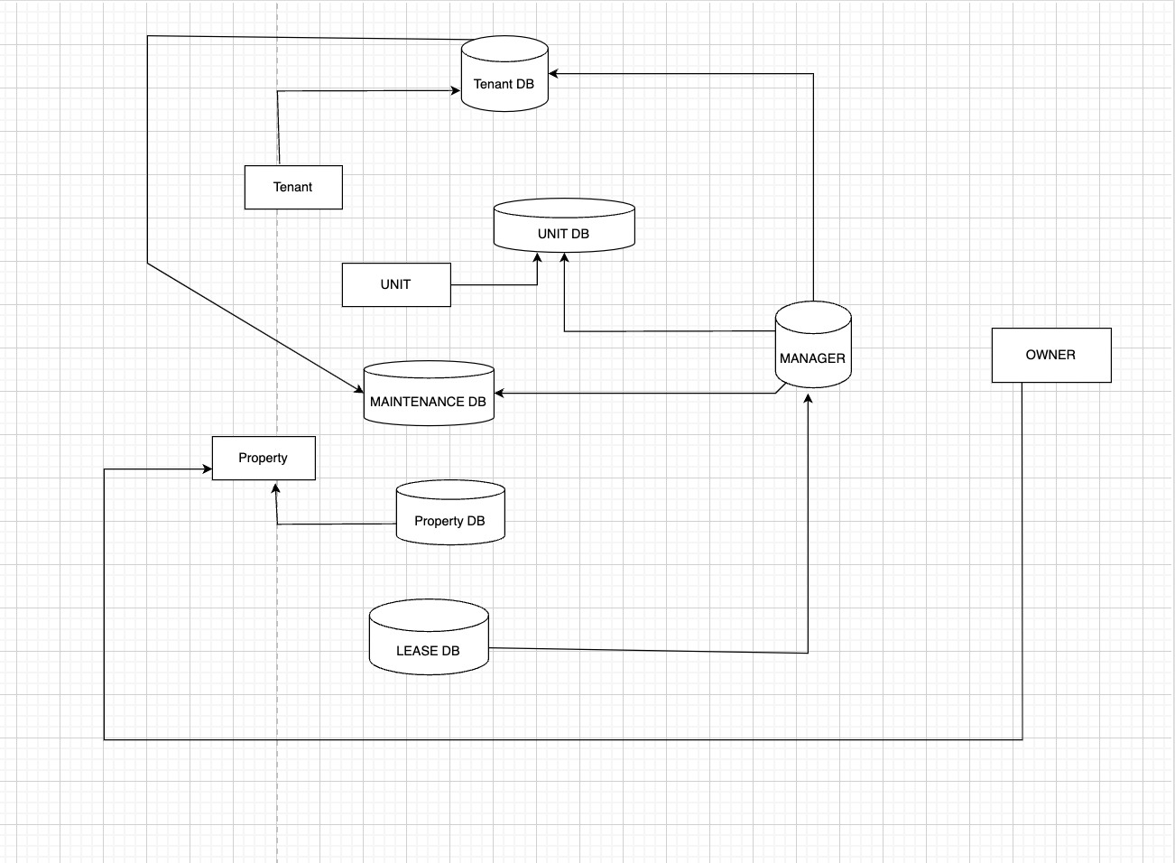
DFD

Slide 9
SECURITY CONSTRAINTS / USER LEVEL ACCESS
Owner has access to the Property entity.
Manager is the whole sole administrator where he has access to control the entities like Unit, Maintenance, Lease, Tenants.
Tenants has access to Unit, Maintenance.

Slide 10
ROLES
ADMIN
MANAGER
OWNER
TENANT

Slide 11
VIEWS
OWNER_UNITS
MANAGER_UNIT_COUNT
VACANT_UNITS
OWNER_REVENUE
TENANT_LEASE_DURATION
MAIN_ISSUES_REPORTED
RESOLVED_MAIN_ISSUES

Slide 12
PACKAGES
MANAGE_MAINTENANCE
MANAGE_UNITS

Slide 13
PROCEDURES
ADD_MAINTENANCE
ADD_UNITS

Slide 14
FUNCTIONS
GET_AVG_UNIT_PRICE
GET_UNRESOLVED_ISSUES
GET_VACANT_UNITS

Slide 15
TRIGGERS
CHECK_PROPERTY
DISPLAY_MAIN_DIFFERENCE
UPDATING_MAINTENANCE

Slide 16
TASKS
ER DIAGRAM - SAMPADA
DFD - AMRUTHA
SECURITY CONSTRAINTS / USER LEVEL ACCESS - VAISHNAVI
ROLES - VAISHNAVI
CREATE STATEMENTS - AKSHITA
INSERT STATEMENTS - ALL
RERUN STATEMENTS - AMRUTHA
VIEWS - ALL
PACKAGES - ALL
PROCEDURES - AKSHITA
FUNCTIONS - AKSHITA
INDEXES - SAMPADA
TRIGGERS - AMRUTHA & SAMPADA
SAMPLE DATA / EXCEL SHEET - ALL

Slide 17
THANK YOU

